Slide 1
Go to Market

Slide 2
Partner Maturity
MPN
Certification
Managed Partner
ASfP
Solution offerings in OCP GTM (catalog)
Azure Expert MSP
Co-Sell
GTM workshops
Smart Partner Marketing
Competency
GTM Services
Qoros Content Hub
Microsoft Partner Use Only
Notes:
https://partner.microsoft.com/en-US/smart-partner-marketing
https://partner.microsoft.com/en-US/reach-customers/gtm
https://partner.microsoft.com/en-us/reach-customers/qorus-content-hub
https://www.microsoft.com/en-us/us-partner-blog/2018/11/15/how-to-stay-connected-and-find-resources-as-a-microsoft-partner/?utm_source=Direct

Slide 3
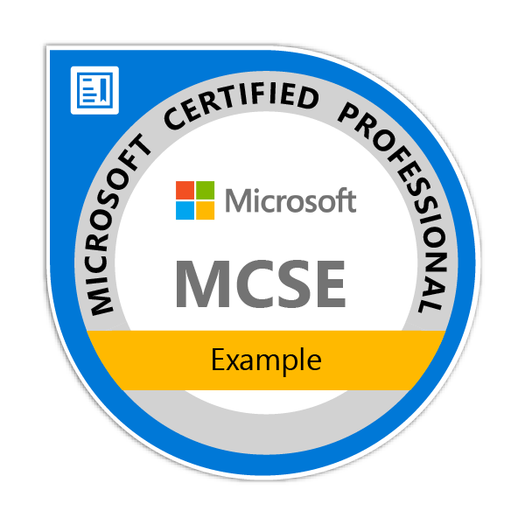
Individual Technical Certifications
Industry-recognized certifications
Individual (you get to keep them)
Prepare with instructor led training, online training, books, practice tests
https://www.microsoft.com/en-us/learning/browse-all-certifications.aspx
https://www.microsoft.com/en-us/learning/certification-overview.aspx

Slide 4
Organization Silver & Gold Competency
Industry-recognized competency
Competency requirements:
Individual certifications
Customer evidence
Competency fees
Company performance requirements
Productivity Competency
Cloud Productivity
Messaging
Communications
Collaboration and Content
Small and Midmarket Cloud Solutions
https://partner.microsoft.com/en-us/membership/competencies#simple-tab-content-6
Mobility Competency
Enterprise Mobility Management
Windows and Devices
https://partner.microsoft.com/en-us/membership/competencies#simple-tab-content-5
Notes:
Objective: Show how the volume and type of collaboration we do has change - > and this has implications on the features we need built into our tools.
Over the past few years, there’s been a dramatic increase in the amount of collaboration.
Employees are on 2x as many teams as 5 years ago
The amount of time employees spend engaged in “collaborative” work – in meetings, on phone calls or answering emails – has increased by about 50%. Perhaps even more significantly, this kind of work now takes up 80% or more of employees’ time.
In addition to an increase in the amount of collaboration, there are other characteristics that are different about how we’re working together today.
People on teams are a mix of employees and outside vendors. For example, already in the US, 40% of the workforce is contingent worker.
Teams have remote members, either remote from home, or because on the road or because located in different geography.
For the first time, 4 generations are working alongside each other and have different expectations about the tools they use to communicate and collaborate.
Main point to land: This increase in the volume of collaboration and the diversity in scenarios has driven an appetite for specialized tools to address new scenarios.
Research citations:
Trend: In 2009, the average IW in the US worked on 1.7 teams; by 2014 that had nearly doubled to 3 teams. Question: Thinking about the projects you are currently involved with, how many collaborative, project based teams are you on? Source: 2009, 2014 US IW Survey
Primary research, conducted on behalf of Microsoft for the Windows and Devices Group.
Audience: The survey is among Information Workers in Enterprise and UMM (250+ employees).
Geographies: US, Japan, India, Germany and Brazil.
The amount of time employees spend engaged in “collaborative” work – in meetings, on phone calls or answering emails – has increased by about 50%. Perhaps even more significantly, this kind of work now takes up 80% or more of employees’ time. Source: University of Virginia, January 2016, How much workplace collaboration is too Much?
Collaboration is taking over the workplace. As business becomes increasingly global and cross-functional, silos are breaking down, connectivity is increasing, and teamwork is seen as a key to organizational success. According to data we have collected over the past two decades, the time spent by managers and employees in collaborative activities has ballooned by 50% or more. Source HBR, Feb 2016, Collaborative Overload
40% of the US workforce is now contingent worker Source: Forbes 2015 http://www.forbes.com/sites/elainepofeldt/2015/05/25/shocker-40-of-workers-now-have-contingent-jobs-says-u-s-government/#478eaaf22532

Slide 5
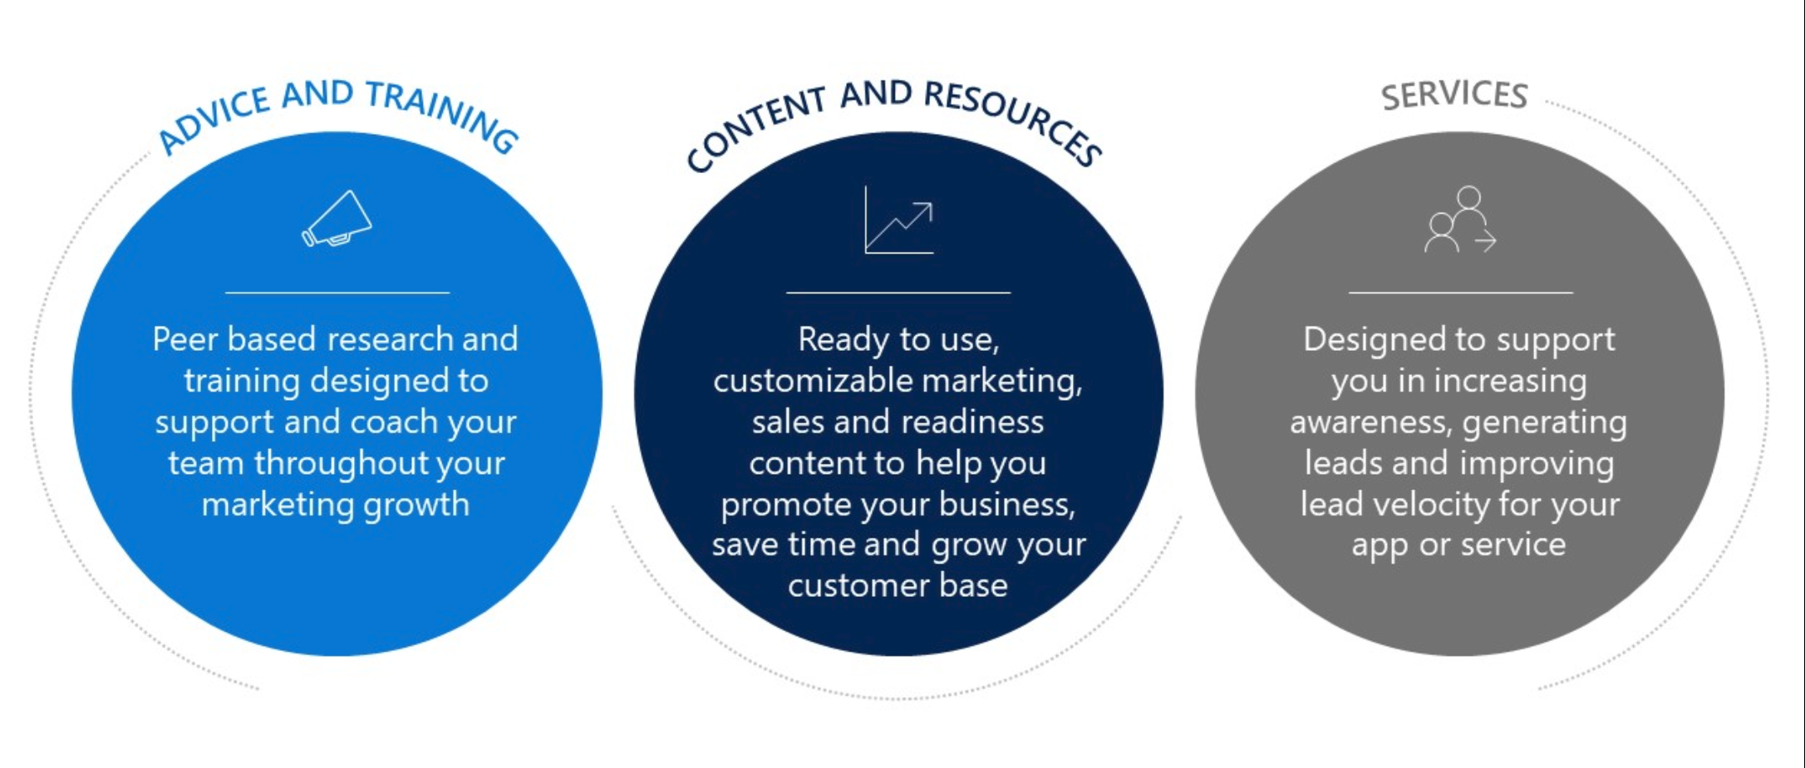
Go-To-Market Programs
Promote your business
partner.microsoft.com/reach-customers/promote-your-business
Microsoft Partner Use Only
Web Direct/Base Price shown

Slide 6
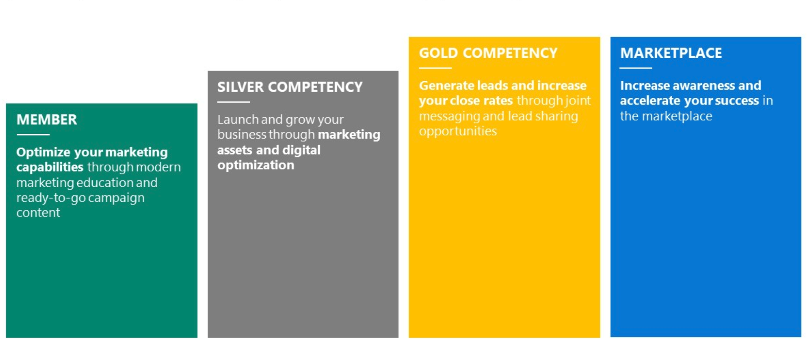
Go-To-Market Benefits
Microsoft Partner Use Only
Web Direct/Base Price shown

Slide 7
Microsoft Partner Network Technical Benefits Structure
Cloud Performance
Competencies: Cloud Platform, Cloud Productivity, Cloud Customer Relationship Management, Small and Midmarket Cloud, and Enterprise Mobility Management
Hybrid
Competencies: App Dev, Collab & Content, Communication, Data Analytics, Data Platform, Datacenter, Dev & Deployment, Messaging, Mid Market Solution Provider, Project & Portfolio Mgmt, and CRM
On Premises
Competencies: All other
Gold
50 Partner Advisory Hours, Technical Presales Assistance, Partner Support Community
20 Product Support Incidents
20 Product Support Incidents
20 Product Support Incidents
Unlimited Signature Cloud Support Incidents
10 Signature Cloud Support Incidents
Silver
20 Partner Advisory Hours, Technical Presales Assistance, Partner Support Community
15 Product Support Incidents
15 Product Support Incidents
15 Product Support Incidents
Unlimited Signature Cloud Support Incidents
10 Signature Cloud Support Incidents
Action Pack
5 Partner Advisory Hours (with your first cloud sale), Partner Support Community
10 Product Support Incidents
Network
Partner Support Community
Online Interactive Sessions

Slide 8
Microsoft Partner Technical Services
Helping partners win more deals, accelerate deployment, increase consumption and support Microsoft solutions throughout every stage of your customer relationships.
Customer lifecycle
Sell
Deploy
Support
Win more deals through Partner focused business and technical consultation, and training:
Technical presales assistance
Accelerate the design & deployment phases, and drive consumption of solutions with technical content, advice and training:
Advisory Hours
Resolve technical roadblocks by engaging with our support teams to resolve problems:
Product support
Signature Cloud Support
Technical training
Microsoft partner online support resources
Partner Technical Services will set your business apart and help you succeed.
Additional support offerings
Advanced Support for Partners
Watch videos
Premier Support for Partners
Partner Technical Services are available through the MPN technical benefits structure, except for the Advanced Support for Partners (aka.ms/asfp) and Premier Support for Partners (aka.ms/premier) support offerings. Visit aka.ms/CoreBenefits, and for more information.

Slide 9
Get Started with Azure
Nominate a Champion
Embrace Internally
Dedicated Employee
Technical & Sales Skills
Conduit for External Information and Internal Questions
Activate your Azure IURs
Learn the Key SMB Workloads
Get Certified
Build a plan & set internal goals
Take advantage of the Hands-On-Labs and Massively Open Online Courseware
Go to Market
Join Azure Mentor Program
Invest, win, and learn from your first few customers
Create solution bundles your team can sell:
Start with Augmenting existing offerings - Identity, Backup, Site Recovery, Storage
Progress to Lift & Shift - extend the network, old server replacements, VMs / RDS / Websites
Now, Go big with marketing Assessments to land new & engage existing customers – leverage Azure Everywhere, BitTitan HealthCheck for Azure
Microsoft Partner Use Only
Web Direct/Base Price shown

Slide 10












Azure Migration Tools
Discover
Migrate
Optimize
Microsoft
Microsoft Assessment and Planning (MAP) Toolkit
Azure Migrate
Database Migration
Assistant
Azure Site
Recovery
Database Migration
Service
Operations
Management Suite
^{Public Preview}
Partners

Slide 11


